Slide 1
Ch. 5 Linked List
When a list is implemented by an array
  Intuitively simple
  Weak points
    Overflow
    Needs shift operation for insertion/deletion
Linked list
  Free from shift overhead
  Overhead for linking

Slide 2
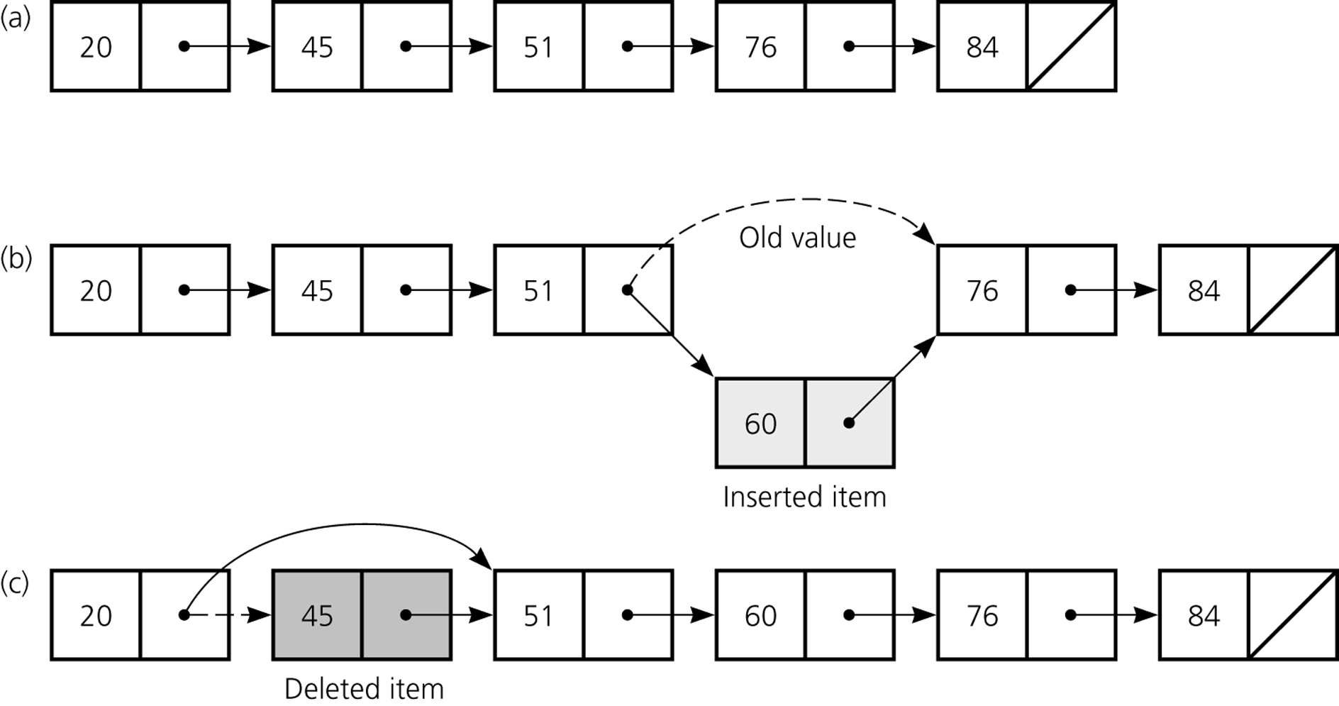
Figure 5.1
a) A linked list of integers; b) insertion; c) deletion

Slide 3
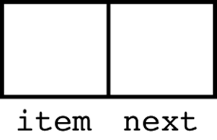
Linked List
Each node contains
  Data (item)
  Link
number, string, object, …

Slide 4
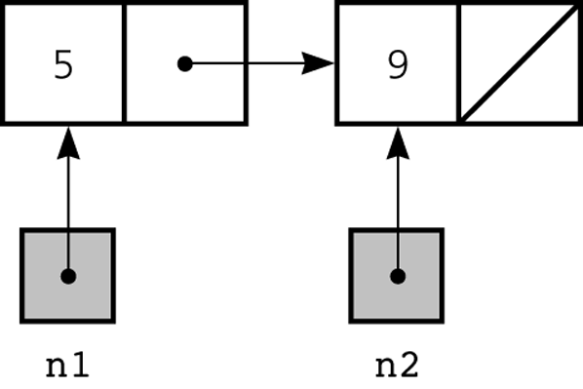
A naïve structure
public class IntegerNode {
public int item;
public IntegerNode next;
}
Not good information hiding
Not good data abstraction
Example:
IntegerNode n1 = new IntegerNode( );
IntegerNode n2 = new IntegerNode( );
n1.item = 5;
n2.item = 9;
n1.next = n2;

Slide 5
An Intermediate Version
public class IntegerNode {
private int item;
private IntegerNode next;
public void setItem(int newItem) {
item = newItem;
}
public int getItem( ) {
return item;
}
public void setNext(IntegerNode nextNode) {
next = nextNode;
}
public IntegerNode getNext( ) {
return next;
}
}
Example:
IntegerNode n1 = new IntegerNode( );
IntegerNode n2 = new IntegerNode( );
n1.setItem(5);
n2.setItem(9);
n1.setNext(n2);

Slide 6
An Improved Version
public class IntegerNode {
private int item;
private IntegerNode next;
// constructors
public IntegerNode(int newItem) {
item = newItem;
next = null;
}
public IntegerNode(int newItem, IntegerNode nextNode) {
item = newItem;
next = nextNode;
}
// setItem, getItem, setNext, getNext as before
…
}
Example:
IntegerNode n2 = new IntegerNode(9);
IntegerNode n1 = new IntegerNode(5, n2);
Example:
IntegerNode n1 = new IntegerNode(5, new IntegerNode(9));

Slide 7
Problems Still Remained
restricted to a single integer field
low reusability
public class IntegerNode {
private int item;
private IntegerNode next;
public IntegerNode(int newItem) {
item = newItem;
next = null;
}
public IntegerNode(int newItem, IntegerNode nextNode) {
item = newItem;
next = nextNode;
}
…
}

Slide 8
A Reusable Version
The Object class is
a superclass of every class
public class Node {
private Object item;
private Node next;
public Node(Object newItem) {
item = newItem;
next = null;
}
public Node(Object newItem, Node nextNode) {
item = newItem;
next = nextNode;
}
public Object getItem( ) {
return item;
}
// setItem, setNext, getNext similar
…
}

Slide 9
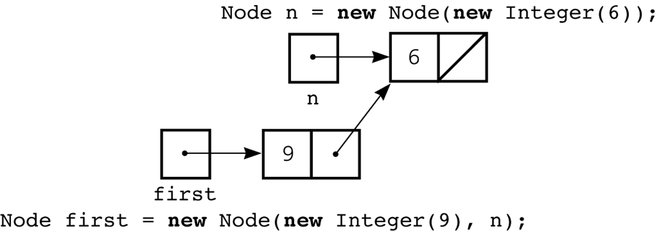
Example:
Node n = new Node(new Integer(6));
Node first = new Node(new Integer(9), n);
Since int is a primitive type, it cannot be an inherited class of Object.
  Integer is a class in package java.lang.
Notes:
~9/19/2007

Slide 10
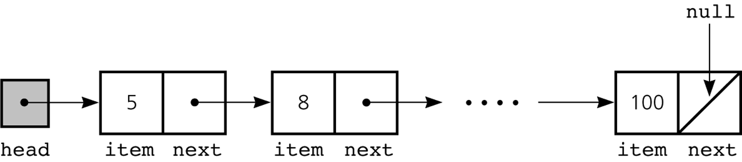
Head Node
Linked lists usually have a head reference
Node head = null;
Node head = new Node(new Integer(5));
Here, head is a simple reference variable

Slide 11
Displaying the Contents
Sequential display of the contents of the linked list referenced by head
for (Node curr = head; curr != null; curr = curr.getNext( )) {
System.out.println(curr.getItem( ));
}

Slide 12
Implementation
Public class Node {
See the slide ahead;
}
public interface ListInterface {
// list operators
public boolean isEmpty( );
public int size( );
public void add(int index, Object item);
public void remove(int index);
public Object get(int index);
public void removeAll( );
}

Slide 13
public class ListReferenceBased implements ListInterface {
private Node head;
private int numItems;
// constructor
public ListReferenceBased( ) {
numItems = 0;
head = null;
}
// operations
public boolean isEmpty( ) {
return numItems == 0;
}
public int size( ) {
return numItems;
}
…

Slide 14
private Node find(int index) {
// return reference to i^{th} node
Node curr = head; // 1st node
for (int i = 1; i < index; i++) {
curr = curr.getNext( );
}
return curr;
}
public Object get(int index) {
if (index >= 1 && index <= numItems) {
Node curr = find(index);
return curr.getItem( );
} else {
Exception handling;
}
}
…

Slide 15
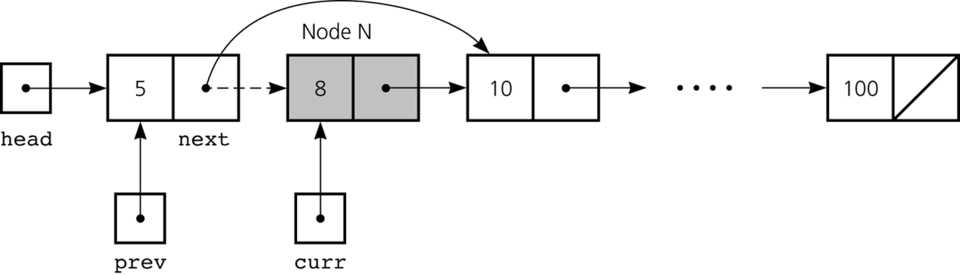
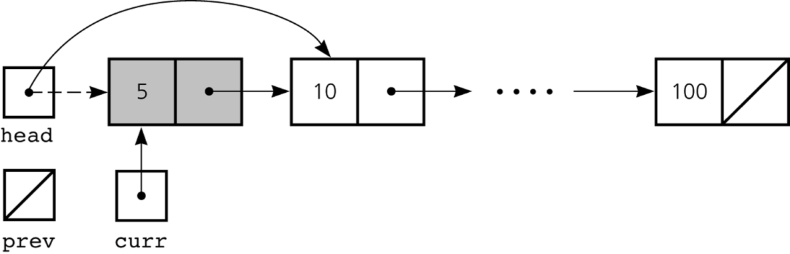
Deleting a Specified Node
Removing the node referenced by variable curr
  The previous node of curr is referenced by prev
prev.setNext(curr.getNext( ));
In C, prev->next = curr->next;
Removing the 1st node
head = curr.getNext( );

Slide 16
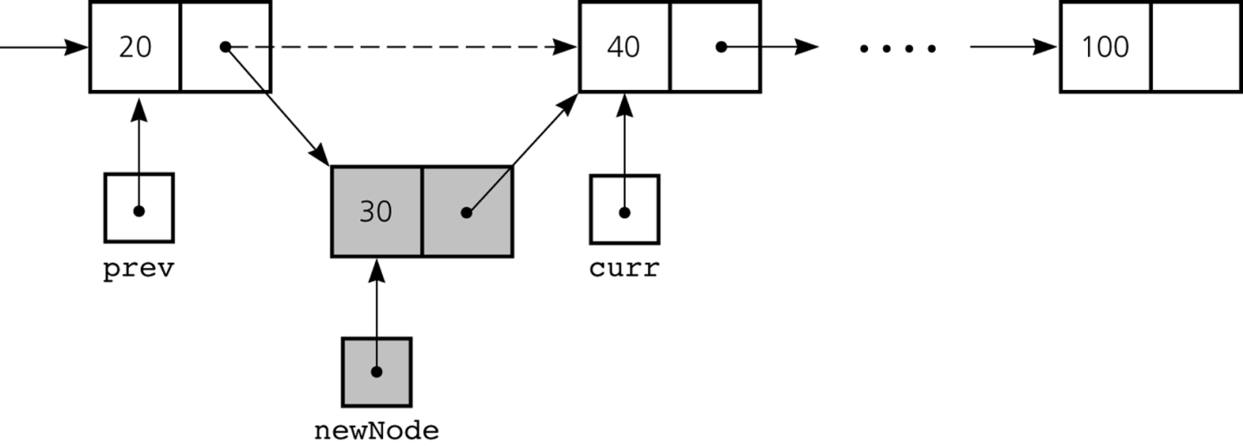
Inserting a Node
Inserting a node between prev and curr
In C,
newNode = malloc(sizeof Node);
newNode->item = 30;
newNode->next = curr;
prev.next = newNode;
newNode = new Node(new Integer(30));
newNode.setNext(curr);
prev.setNext(newNode);

Slide 17
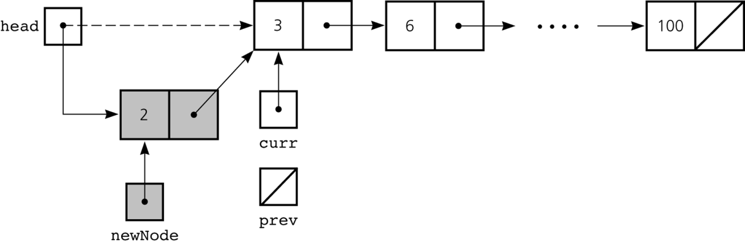
Inserting a node in front of the 1st node
newNode = new Node(new Integer(2));
newNode.setNext(head);
head = newNode;
In C,
newNode = malloc(sizeof Node);
newNode->item = 2;
newNode->next = head;
head = newNode;

Slide 18
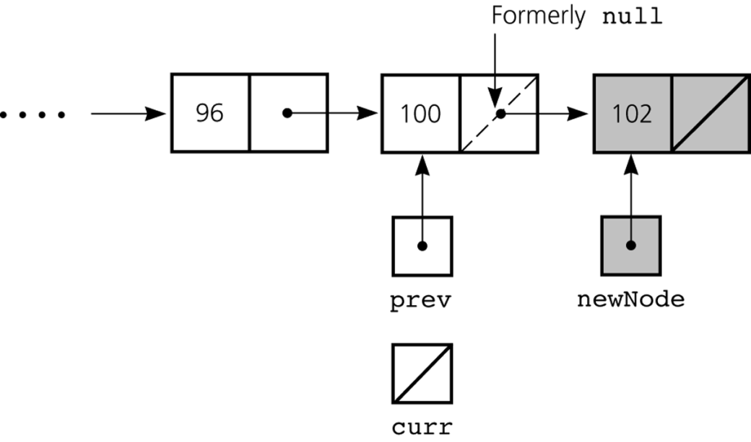
Inserting a node after the last node (no special case)
newNode = new Node(new Integer(102));
newNode.setNext(curr);
prev.setNext(newNode);
No need for special handling if curr = null
Notes:
~3/17/2003(제2강)

Slide 19
prev
curr
Implementation of Deletion
public class ListReferenceBased implements ListInterface {
private Node head;
private int numItems;
…
public void remove(int index) {
if (index >= 1 && index <= numItems) {
if (index == 1) head = head.getNext( );
else {
Node prev = find(index – 1);
Node curr = prev.getNext( );
prev.setNext(curr.getNext( ));
}
numItems--;
} else {Exception handling;}
}
…
}
Notes:
~9/27/2010

Slide 20
Implementation of Insertion
head
…
public class ListReferenceBased implements ListInterface {
private Node head;
private int numItems;
…
public void add(int index, Object item) {
if (index >= 1 && index <= numItems+1) {
if (index == 1) {
Node newNode = new Node(item, head);
head = newNode;
} else {
Node prev = find(index – 1);
Node newNode = new Node(item, prev.getNext( ));
prev.setNext(newNode);
}
numItems++;
} else {Exception handling;}
}
…
}
item
prev
…
item

Slide 21
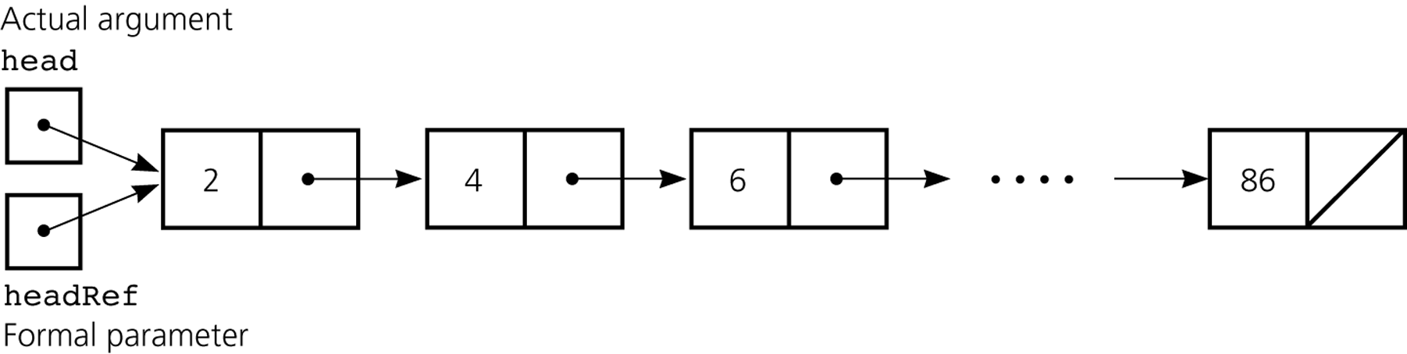
Passing a Linked List to a Method
…aMethod(head)…

Slide 22
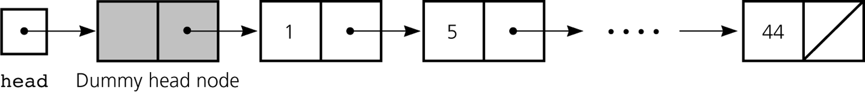
Dummy Head Node
Put a dummy head node in front of the list
  No need of special handling related to the 1st node
Initialization/Constructor
public class ListReferenceBased implements ListInterface {
private Node head;
private int numItems;
public ListReferenceBased( ) {
numItems = 0;
head = new Node( );
head.setNext(null);
}
…
}
head
Dummy head node

Slide 23
Cf. W/o Dummy Node
Initialization/Constructor
public class ListReferenceBased implements ListInterface {
private Node head;
private int numItems;
public ListReferenceBased( ) {
numItems = 0;
head = null;
}
…
}
head

Slide 24
Deletion When the Dummy Node Exists
public class ListReferenceBased implements ListInterface {
private Node head;
private int numItems;
…
public void remove(int index) {
if (index >= 1 && index <= numItems) {
Node prev = find(index – 1);
Node curr = prev.getNext( );
prev.setNext(curr.getNext( ));
numItems--;
} else {Exception handling;}
}
…
}

Slide 25
Cf. W/o Dummy Node
public class ListReferenceBased implements ListInterface {
private Node head;
private int numItems;
…
public void remove(int index) {
if (index >= 1 && index <= numItems) {
if (index == 1) head = head.getNext( );
else {
Node prev = find(index – 1);
Node curr = prev.getNext( );
prev.setNext(curr.getNext( ));
}
numItems--;
} else {Exception handling;}
}
…
}
if (index == 1) head = head.getNext( );
else {
Node prev = find(index – 1);
Node curr = prev.getNext( );
prev.setNext(curr.getNext( ));
}
numItems--;
numItems--;
Notes:
~9/17/2003

Slide 26
Utilization of the Dummy Node
We can use the empty item field
head
Dummy head node
3
5
89
5
24
89
length
largest
smallest
public class ListInfo {
private int length;
private Object smallestItem, largestItem;
// methods for accessing the private data—length, smallestItem, largestItem—appear here
…
} // end class
Notes:
~3/28/2007(제4강)
~3/19/2012

Slide 27
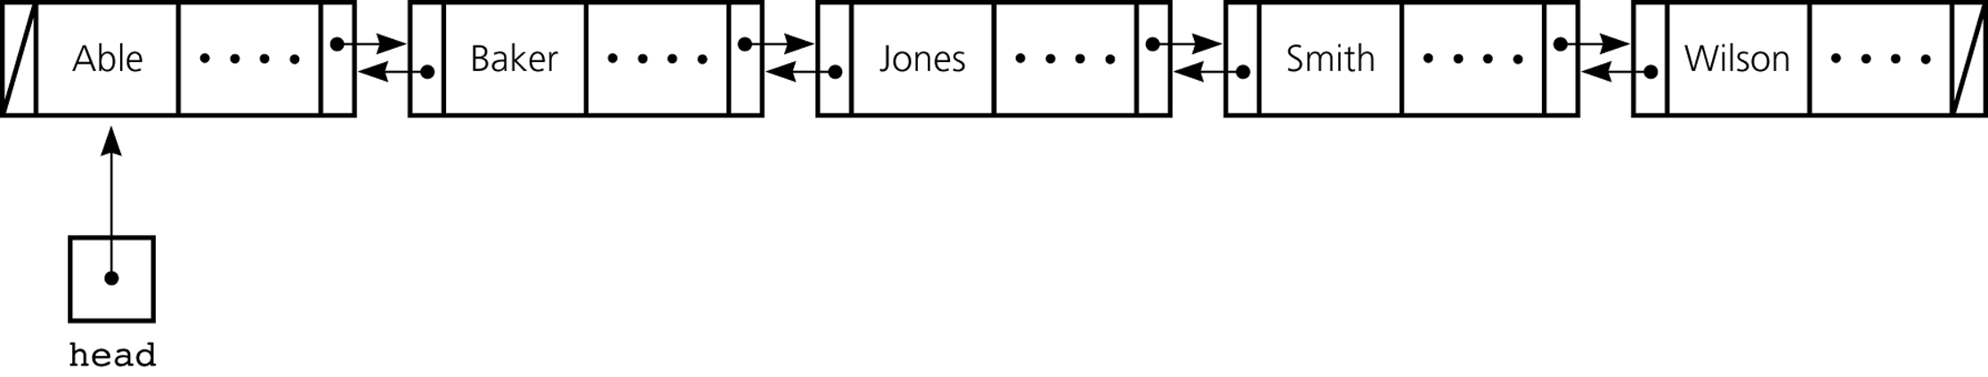
Doubly Linked List

Slide 28
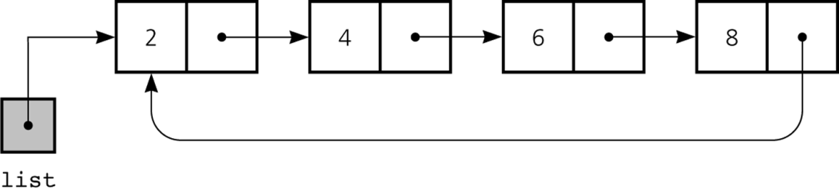
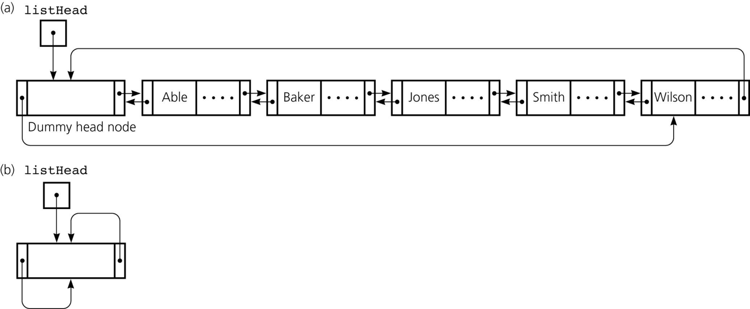
Circular Linked List
Singly linked list
Doubly linked list
Initial state
Notes:
~9/22/2008

Slide 29
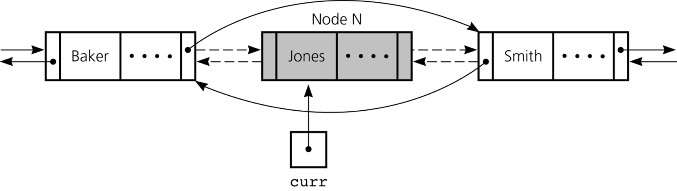
Deletion in Doubly Linked List
No need to save the prev node
When there exist nodes in both sides
curr.getPrecede( ).setNext(curr.getNext( ));
curr.getNext( ).setPrecede(curr.getPrecede( ));
We still need a special treatment
    for the case that there is no node in at least one side

Slide 30
Deletion in Circular Doubly Linked List w/ Dummy Head Node
Dummy head node
 |  | …
 | Jones | …
curr
No need of special treatment for the case of absence in any side
curr.getPrecede( ).setNext(curr.getNext( ));
curr.getNext( ).setPrecede(curr.getPrecede( ));

Slide 31
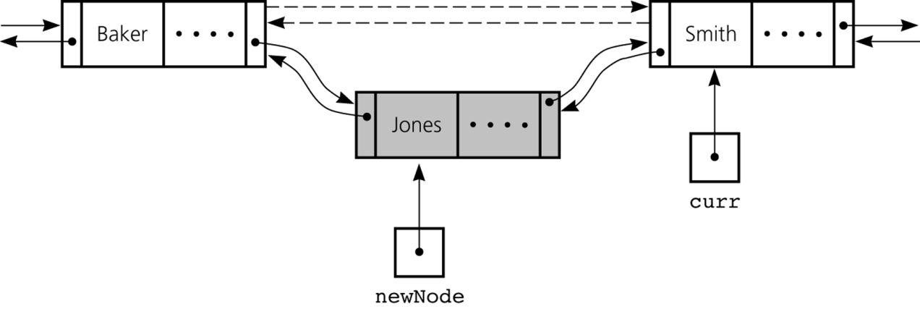
Insertion in Doubly Linked List
When there exist nodes in both sides
newNode = new dListNode(…);
newNode.setNext(curr);
newNode.setPrecede(curr.getPrecede( ));
curr.getPrecede( ).setNext(newNode);
curr.setPrecede(newNode);
or
newNode = new dListNode(… curr.getPrecede( ), curr, …);
Curr.getPrecede( ).setNext(newNode);
Curr.setPrecede(newNode);
Otherwise?

Slide 32
An Example: Sparse Polynomial
-3x⁷ + 4x⁵ + 7x³ –x² + 9
Dummy head
5
#terms

Slide 33
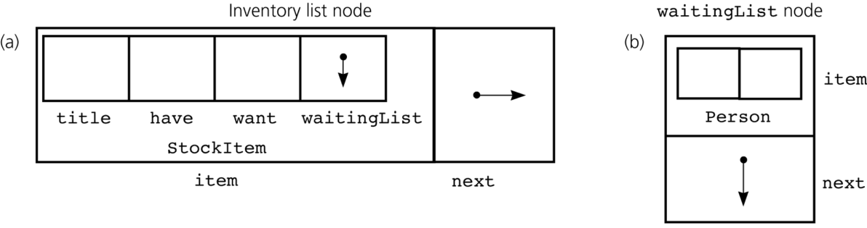
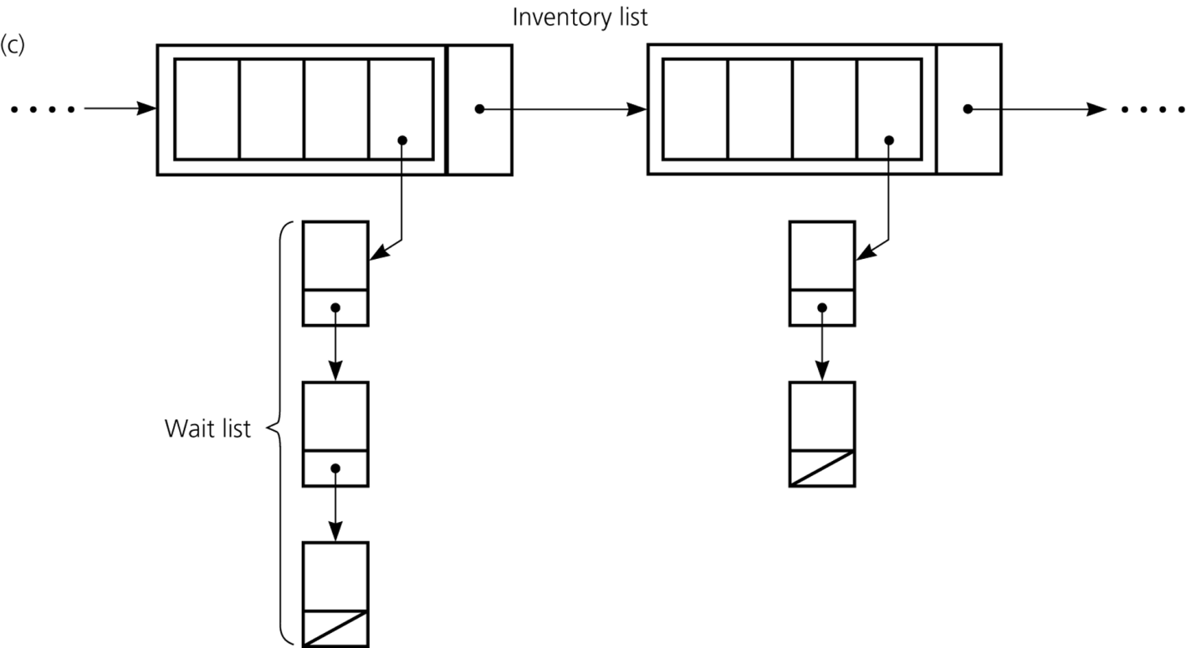
A Mixed Structure
Notes:
~9/21/2004

Slide 34
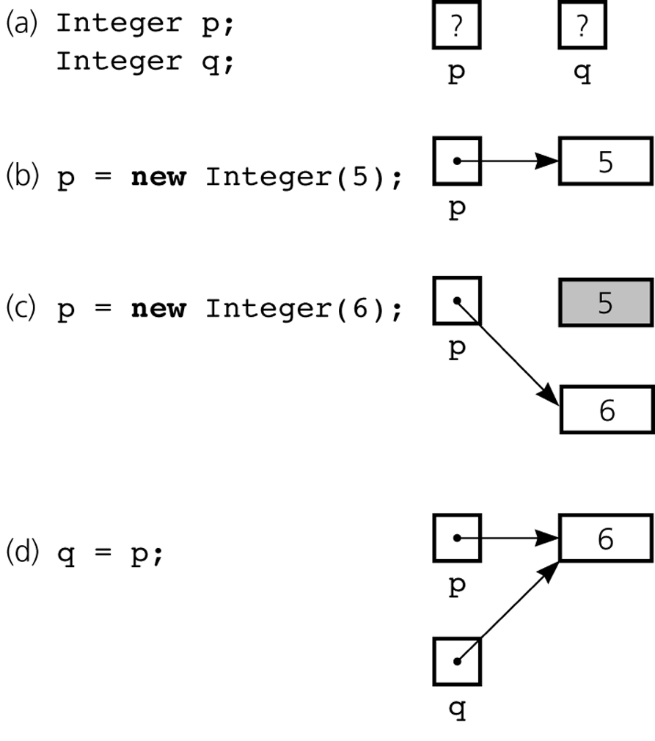
JAVA Object References
Declaring reference variables
Allocating an object
Allocating another object,
w/ the dereferenced object
marked for garbage collection
Assigning a reference

Slide 35
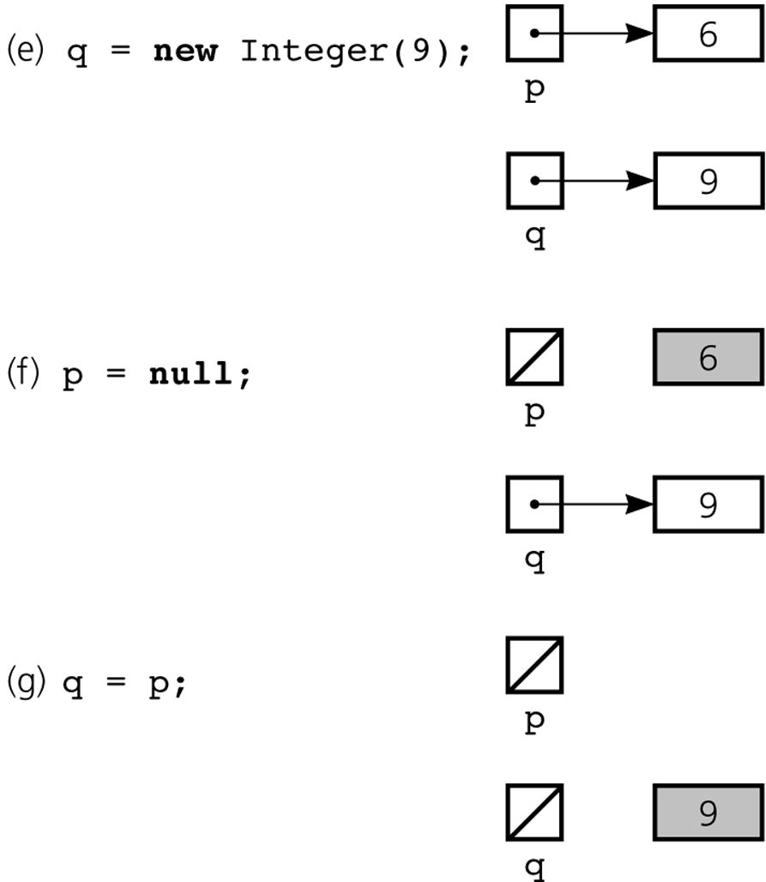
Allocating an object
Assigning null
to a reference variable
Assigning a reference
with a null value

Slide 36
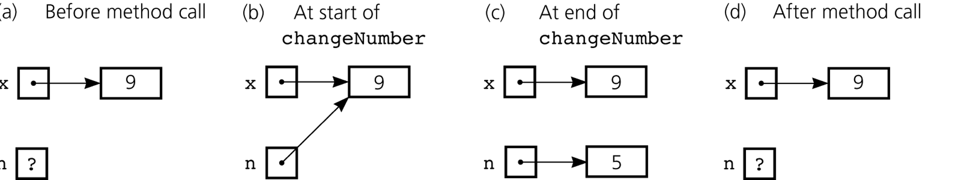
Call by Value
Integer x = new Integer(9);
changeNumber(x); // attempts to assign Integer(5) to x
public void changeNumber(Integer n) {
n = new Integer(5);
}
Notes:
~9/28/2005
~3/26/2008
~3/25/2009

